Slide 1
Shopping Wizzard
Luis Molina, Ivan Gunchev, Adrián Serrano, Corina Pérez

Slide 2
Explain what lessons you’ve learned during this project
Communication between all team members is very important. We have improved our teamwork.
We have much more control over CSS selectors and we have improved the use of the DOM.
How to work with git and github.

Slide 3
What problems have you encountered when developing this project?
We struggled a bit with the organization at the beginning.
As it was the first time we were all working with GIT, we had trouble understanding it and uploading the files.

Slide 4
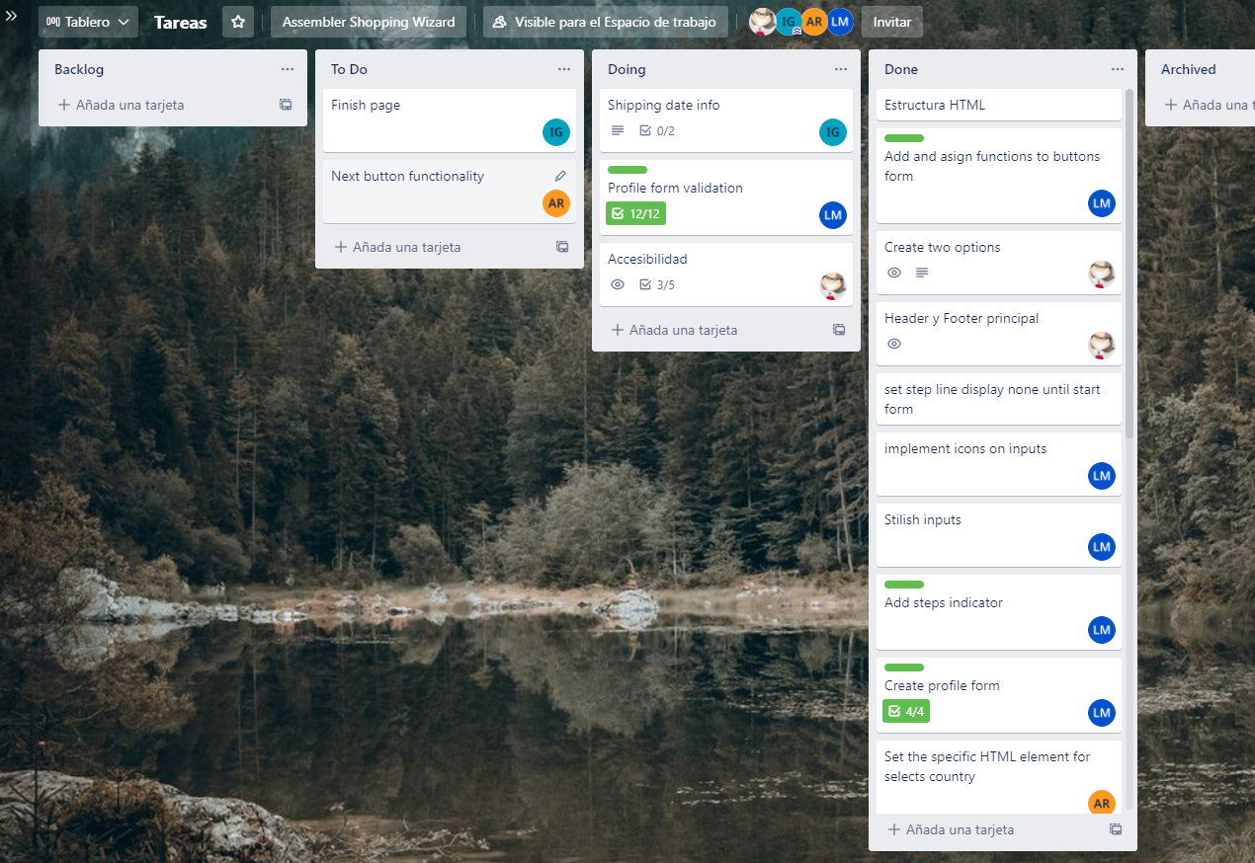
How we designed tasks
In this case, we use trello for this function, we manage very well

Slide 5
Explain how you changed roles to develop the project for each phase (screen)
We decided that the most practical way was to divide the sections, making one each.
We worked on different branches until the javascript was finished. Then we merged the work and did pair-coding.

Slide 6
The entire project in sections
The product page was created by Corina.
The profile form section was created by Luis.
The address form section was created by Adrián.
The shipping section was created by Iván.
We worked together in the finish section, using the variables and the styles.

